Slide 1
PGVCL Training
Day-9

Slide 2
Flutter Training for PGVCL Department
Day 9 : Plugin Development and Platform Channels

Slide 3
Overview
Topics We’ll Be Covering For Today
Theory
Creating custom plugins.
Communicating with native code using platform channels.
Practical
Build a plugin that interacts with the device camera or accelerometer.
Assignment
Add a feature to capture and save photos using the custom plugin.

Slide 4
Objectives
Understand the purpose and advantages of custom plugins in Flutter.
Learn how to use platform channels to communicate with native code.
Develop a custom plugin to interact with native device features.

Slide 5
What Are Plugins in Flutter?
Definition:
Plugins are reusable packages that enable Flutter apps to access platform-specific functionality.
Types of Plugins:
Dart-only Plugins: Implemented entirely in Dart, no native code required.
Platform-specific Plugins: Use platform channels to integrate native code for Android (Kotlin/Java) or iOS (Swift/Objective-C).

Slide 6
Why Create Custom Plugins?
Access device-specific functionality not available in existing plugins.
Enhance app performance by leveraging native APIs.
Share reusable code across multiple projects.
Extend Flutter's capabilities for enterprise or specific use cases.

Slide 7
Understanding Platform Channels
What Are Platform Channels?
A mechanism for communication between Dart code and native code.
How It Works:
Flutter sends a method call to the native platform via the channel.
Native code processes the request and sends a response back.
Diagram:
Flutter App ↔ Platform Channel ↔ Native Code (Android/iOS)

Slide 8
Key Classes and Methods
MethodChannel:
Sends messages from Dart to the platform.
Example: MethodChannel('com.example.channel').
BinaryMessenger:
Handles low-level communication between Flutter and the platform.
Native Handlers:
Android: Handles requests using Kotlin/Java.
iOS: Handles requests using Swift/Objective-C.

Slide 9
Practical: Build a Custom Plugin
Objective: Create a plugin that interacts with device features.
Steps:
Set up the plugin:
Use flutter create --template=plugin plugin_name.
Define the platform channel:
Create a MethodChannel in Dart.
Implement native code:
For Android: Use CameraManager or SensorManager.
For iOS: Use AVFoundation or CoreMotion.
Test the plugin:
Integrate the plugin into a sample Flutter app.

Slide 10
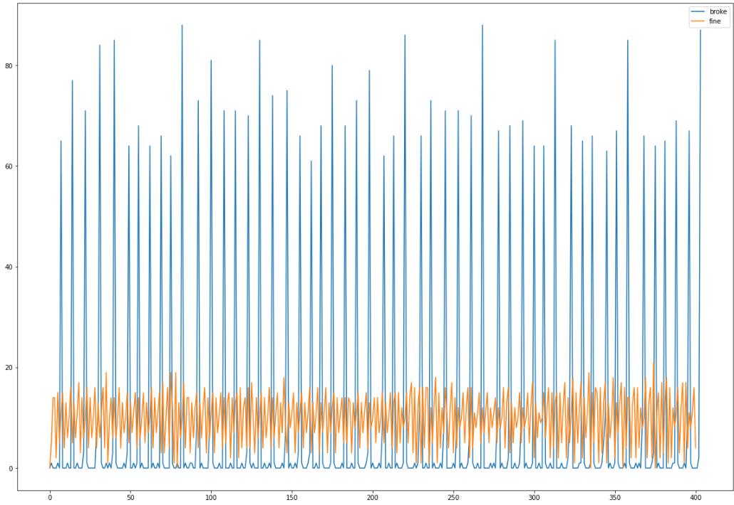

Slide 11
Practical Example
Link
Assignment Example
Create a basic UI with 3 Stateless Widgets and 2 Stateful Widgets

